Slide 1
Chapter 3
Tuning the IDS
- Tuning Snort
-IDS Placements
Muhammad Shafiq Bin Othman

Slide 2
SNORT
SNORT is an open-source network IDS.
It can also be used as a “packet sniffer” and packet logger.
When Snort is run in the sniffer mode, it displays the contents of every packet traversing the line directly to the console.
It can display packet headers, as well as packet payloads.

Slide 3
SNORT
NIDS mode is similar to the sniffer mode, in that it collects every packet it encounters.
Instead of simply copying the data to a file or displaying it to a monitor, Snort inspects each packet and determines whether it is benign or malicious in nature.
Snort then sends alerts when it finds suspicious-looking traffic.

Slide 4
SNORT
If tuned properly, Snort is capable of monitoring every packet in a fully saturated 100Mb/s network.
Snort begins to experience packet loss around the 200-300Mb level, and cannot be run at traffic levels higher than 500Mb.
Thus it is not suitable for use in modern gigabit networks.

Slide 5
SNORT
Component 1:
Gathering Intrusion Data

Slide 6
SNORT
Gathering intrusion data
  A powerful feature of Snort is related to its capability of gathering data.
  Many commercial IDS require the operator to specify in advance for which rules data should be kept.
  It is very difficult to know in advance the attacks at which the protected network will be exposed to.

Slide 7
SNORT
Gathering intrusion data (cont.)
  The only solution is to save every payload (actual data in a packet) that corresponds to suspicious traffic.
  Snort does exactly this – it logs all payloads when possible.
  Consequence: a lot of memory is needed.

Slide 8
SNORT
Component 2:
Data Preprocessing

Slide 9
SNORT
Preprocessing the data to be inspected
  Snort has a class of plug-ins, known as pre-processors, that interact with data before the detection engine processes them.
  Three functional groups of pre-processors:
    Data Normalization
    Protocol Analysis
    Non-Signature-Matching Detection.

Slide 10
SNORT
Preprocessing the data to be inspected (cont.)
  Data normalization (process of organizing attributes of the data to reduce ambiguities in interpretation of the data)
    New methods of attack and IDS evasion are constantly evolving that Snort detection engine either does not detect or does not detect efficiently.
    Pre-processors are added to the Snort architecture to normalize data so that the detection engine can properly interpret them.

Slide 11
SNORT
Preprocessing the data to be inspected (cont.)
  Protocol analysis
    The SNORT detection engine has a short list of protocols that it can interpret.
    Others, including some protocols that are heavily used over public networks, cannot be interpreted.

Slide 12
SNORT
Pre-processing the data to be inspected (cont.)
  Non-Signature-Matching Detection
    Some types of malicious traffic do not have a comparable signature.
    This class of pre-processor uses anomaly-based methods other than signature matching to detect suspicious traffic.
    Examples:
      Reconnaissance (recognition) attacks (port scanning, etc.)
      Some DoS attacks (where traffic is normal, but consumes bandwidth and CPU time in such a way that the service in question becomes unavailable.

Slide 13
SNORT
Component 3:
Rules
(Detection Engine)

Slide 14
SNORT
With Snort, a malicious traffic signature is used to create a rule that is loaded into the Snort detection engine.
The detection engine is the primary component of Snort and is responsible for signature matching.
SNORT can also use heuristics(data collection) to detect malicious traffic that has no signature.→ Anomaly based detection

Slide 15
SNORT
Three groups of Snort rules:
  Suspicious packet headers detection
  Suspicious packet payload detection
  Specific protocol elements control
Initial SNORT installation includes a number of predefined rules, intended to be generic for all networks.
Then, a set of rules specific for the network in question is written.

Slide 16
SNORT
SNORT Rules Examples

Slide 17
SNORT
Rules Examples:
Suspicious Packet Headers Detection

Slide 18
SNORT
Suspicious packet headers detection
  Example: Suspicious packet headers detection
    The ICMP (Internet Control Message Protocol) ping used by the NMAP tool (to determine whether a host at a particular IP address is running) has a specific signature.
    It sets the ICMP type field to 8 and has an empty data payload.
    This NMAP ping signature is different than a ping issued directly from a Windows or Unix operating system.
    Since NMAP has a unique-looking ping, it is possible to create a rule that triggers whenever traffic matching this signature hits the protected network.

Slide 19
SNORT
Suspicious packet headers detection (cont.)
  Example (cont.)
    The Snort rule for this is the following:
      alert icmp $EXTERNAL_NET any -> $HOME_NET any
      (msg: “ICMP PING NMAP"; dsize: 0; itype: 8;)
    Generate an alert for ANY ICMP traffic that originates outside the protected network AND has an empty data payload AND has the ICMP type field set to 8.

Slide 20
SNORT
Rules Examples:
Suspicious Packet Payload Detection

Slide 21
SNORT
Assessing threats
  Payload data can help the operator to determine whether an attack is being perpetrated by a human or not.
  If it ends up that a human is behind the attack, one might be able to use payload data to determine the attacker's skill level.

Slide 22
SNORT
Suspicious packet payload detection
  Example:
    alert tcp $EXTERNAL_NET any -> $HOME_NET 139
    (msg: "DOS SMBdie attack"; flags: A+; content: “|57724c65680042313342577a|”;)
    This rule states that an alert should be generated if any TCP traffic that contains “|57724c65680042313342577a|” in the payload is found to be headed from outside the protected network to a computer running the Server Message Block (SMB) service.

Slide 23
SNORT
Suspicious packet payload detection (cont.)
  Example (cont.)
  *Port 139 is utilized by NetBIOS Session service. Enabling NetBIOS services provide access to shared resources like files and printers not only to your network computers but also to anyone across the internet. Therefore it is advisable to block port 139 in the Firewall.*
    This payload means a buffer overflow in the Windows protocol, which would bring down the target host.
    This rule triggers only when this payload is aimed at a computer running Netbios (TCP port 139) from the outside.
    The rule is made specific to Netbios sessions to reduce the possibility of a false alert.

Slide 24
SNORT
Rules Examples:
Specific Protocol Elements Control Rule

Slide 25
SNORT
Specific protocol elements control
  For accuracy and performance reasons, Snort signatures can be specific to one element of a particular protocol.
  Example:
    alert tcp $EXTERNAL_NET any -> $HTTP-SERVERS $HTTP-PORTS
    (msg:"WEB-IIS ISAPI .ida attempt"; uricontent: ”.ida?” ; nocase; dsize:>239; flags:A+; )
  The .ida extension is a rarely used component of Microsoft's IIS Indexing Service.

Slide 26
SNORT
Specific protocol elements control (cont.)
  Example (cont.)
    This rule states that any network traffic coming from the external network that is intended for the Web servers of the protected network that has .ida? in the URL creates an alert.
    The .ida extension was found to have a serious remote buffer overflow that could result in remote control of the Web server.
    This type of rule is more efficient because it searches URL content only, instead of the entire payload.

Slide 27
SNORT-end here
Rules Examples:
Custom Rules

Slide 28
SNORT
SNORT custom rules
  The goal in creating effective signatures is to write rules that match exclusively the network traffic we want to discover.
  Unfortunately, this goal is almost impossible to attain; each rule is likely to trigger on other traffic too.

Slide 29
SNORT
SNORT custom rules (cont.)
  When writing a rule, one should make a best effort to narrow down the rule to trigger on only the isolated traffic patterns of which one wants to be alerted.
  One should also take care not to add too many traffic properties, which would cause legitimate attacks to not match the rule.

Slide 30
SNORT
SNORT custom rules (cont.)
  To write rules that will trigger only on the traffic we intend them to, we must research and discover properties of the traffic that are unique.
  The individual properties of the traffic need not be unique themselves, but the combination of them should be.

Slide 31
SNORT
SNORT custom rules (cont.)
  Snort rules have a basic syntax that must be adhered to for the rule to properly match a traffic signature.
  Violating the Snort rules syntax can cause a rule to not load into the detection engine.
  Even if such a rule does manage to load, incorrect rule syntax may result in unpredictable and unintended consequences.

Slide 32
SNORT
SNORT custom rules (cont.)
  It is therefore important to make sure the custom rules are written in the correct syntax.
  It is a good practice to check rules over and test them before implementing the rules in a production situation.

Slide 33
SNORT
SNORT custom rules (cont.)
  The most basic syntactical requirement of a Snort rule is that it be in a single line.
  lf we must separate the rule into more than one line, we must append a backslash to the end of the line to let Snort know to continue on the next line.

Slide 34
SNORT
SNORT custom rules (cont.)
  The syntax of the rule header is:
    Rule_action protocol source_address_range source_port_range direction_operator destination_address_range destination_port_range
  The rule action, protocol, and direction operator are normally chosen from a static list of possible values.

Slide 35
SNORT
Custom rules
  Although generic rules provide some intrusion monitoring coverage, a higher degree of rule granularity(scale of detail) is the most effective means of increasing coverage.
  The capability of writing custom rules is a very desirable feature of Snort.
  The rule syntax is fairly simple and thus custom rule writing is relatively easy for those who possess solid knowledge of their own network.

Slide 36
SNORT
Custom rules (cont.)
  Example: writing a rule that alerts whenever a suspicious traffic directed towards the SSH server arrives from a particular URL.
    alert tcp 192.168.1.1 any -> $HOME_NET 22
    (msg: "suspicious host SSH traffic";)
Rules can be written to match any traffic signature or payload.

Slide 37
SNORT
Component 4:
Alert/ Reporting
(Output Module)/

Slide 38
SNORT
Alerting
  Snort's output plug-ins are the means Snort has to get intrusion data from the detection engine to the operator.
  Like its pre-processors, Snort's outputting functionality is modular and pluggable.
  Different skill levels, network configurations, and personal preferences will dictate which outputting mechanism is appropriate for the particular environment.

Slide 39
SNORT
Alerting (cont.)
  Snort supports everything from a raw binary tcpdump output to various relational database outputs.
  Snort's outputs are not intended to be human-readable.
  They are logged in various formats that make intrusion data readily accessible to other applications or tools.

Slide 40
SNORT
Alerting (cont.)
  Outputting can be done in these formats:
    syslog
    tcpdump
    Text log file
    XML
    Relational database
    SNMP
    Snort Unified

Slide 41
SNORT
Alerting (cont.)
  The Snort designers have left the presentation of data to previously written applications.
  Snort supports every major relational database platform (Microsoft SQL Server, Oracle, MySQL, Postgre SQL, etc.)

Slide 42
SNORT
Aggregating data
  Outputting to an industry standard format such as syslog lets the operator aggregate data from many disparate security devices.
  Most routers and firewalls support functionality to log to a syslog server.

Slide 43
SNORT
Aggregating data (cont.)
  It is possible to import logs from other devices into the Snort database structure with logsnorter.
  It is convenient to have all logging and intrusion-related information in one easily secured location.
  Aggregation via syslog is a simplified means of performing event correlation.

Slide 44
SNORT
Aggregating data (cont.)
  Event correlation
    Event correlation is the act of associating occurrences of events as they happened at different devices on a system or across a range of systems.
    Event correlation is critically important to intrusion detection.
    Attackers rarely compromise a single host and walk away.
    Most attacks involve an attacker compromising a single host and then leveraging legitimate privileges to penetrate deeper within a protected network.

Slide 45
SNORT
IDS
Displaying alerts
  Intrusion detection is not an automated process.
  It requires a human to receive the alerts and react to them in a timely fashion.
  Getting real-time alerts out of Snort and to the operator can be configured in many ways.

Slide 46
SNORT
IDS
Displaying alerts (cont.)
  The two primary means for alerting are
    Real-time alerting with syslog and swatch
    Analysis Console for Intrusion Databases (ACID).

Slide 47
SNORT
Displaying alerts (cont.)
  Swatch
    Actively monitors a syslog file for preconfigured events and generates an alert when conditions are met.
    Alerts can be sent via a number of means (e-mail, audible alarm, etc.)

Slide 48
SNORT
Displaying alerts (cont.)
  ACID
    A Web application that reads intrusion data stored in a database and presents the data in a browser.
    ACID presents Snort data in a human-readable format and includes functionality to perform complex searches.
    Complex searches can be created with more than 30 different criteria to pinpoint events occurring in intrusion data.
    This level of accuracy is necessary to quickly identify and eliminate false positives.

Slide 49
SNORT
Displaying alerts (cont.)
  ACID (cont.)
    Can group alerts into logically functional categories.
    Matches links to various common vulnerabilities and exposures (CVE) on the Internet.
    CVE is a standardized classification of vulnerabilities and exposures, and a significant resource for identifying and understanding attacks.

Slide 50
SNORT
Displaying alerts (cont.)
  ACID (cont.)
    ACID can distinguish multiple installations of Snort from each other, and process data from other security devices.
    This makes ACID another option for event correlation through aggregation.

Slide 51
SNORT
End here
Displaying alerts (cont.)
  ACID (cont.)
    Includes a charting component that is used to create statistics and graphs.
    It can be useful to chart how the threat to the protected network changes over time.
    It can also be useful for accomplishing network management tasks.

Slide 52
SNORT
Prioritizing Alerts
  An IDS needs to be able to categorize and prioritize alerts in an organized manner.
  Not all alerts deserve the same attention and scrutiny.
  Example: A simple ping is no cause for immediate alarm, but a remote exploit attempt against an unpatched server is.

Slide 53
SNORT
Prioritizing Alerts (cont.)
  Types of alerting in an IDS:
    No prioritization
    Hard-coded prioritization
    Customizable prioritization

Slide 54
SNORT
Prioritizing Alerts (cont.)
  No Prioritization
    In this system, all alerts have the same priority.
    This makes sorting by severity impossible.
    Any automatic emergency notification mechanism is rendered useless.
    A very bad idea - not prioritizing alerts leaves the IDS analyst frustrated and ultimately disinterested in intrusion monitoring.

Slide 55
SNORT
Prioritizing Alerts (cont.)
  Hard-coded Prioritization
    This is only marginally better than no prioritization.
    Here the IDS designer has decided for the customer which alerts are important and which are not.
    Usually, they are categorized as High, Medium, and Low.
    Although this does allow the operator to sort and filter out less important alerts, such an approach to alerting is inadequate.

Slide 56
SNORT
Prioritizing Alerts (cont.)
  Hard-coded Prioritization (cont.)
    In this system, it is possible to generate alerts regarding irrelevant events for the particular environment.
    Example: an Apache Web server alert, categorized as a high risk by the IDS designer, is generated even if Apache is not installed at all.

Slide 57
SNORT
Prioritizing Alerts (cont.)
  Customizable Prioritization
    The preferred way to group alerting data is by user-defined priorities.
    Modern networks are modular and therefore unique, so customizable prioritization of alerts is necessary.
    Alerts can be sorted based on the priorities of the customer, so alerts are generated according to the organization’s needs.
    Having more than three severity levels for alerts is desirable.

Slide 58
SNORT
Prioritizing Alerts (cont.)
  Customizable Prioritization (cont.)
    Snort supports customizable prioritization of alerts.
    The severity level of each of the categories can be modified arbitrarily.
    The operator can also add as many custom alert categories as required.
    Like signatures, alert classification is performed via simple rules.

Slide 59
SNORT
END HERE
Prioritizing Alerts (cont.)
  Customizable Prioritization (cont.)
    Modules can be used to log intrusion data in any format from raw output to point-and-click GUIs.
    The operator is not limited to using only one alerting output method.
    It is possible to choose as many outputting methods as necessary.

Slide 60
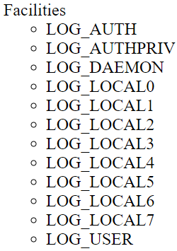
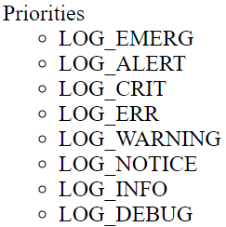
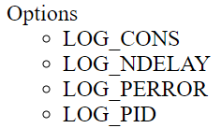
SNORT
END HERE
Prioritizing Alerts (cont.)
  Customizable Prioritization (cont.)
    Example: Alert_syslog in Snort.
    This module sends alerts to the syslog facility allows the user to specify the logging facility and priority within the Snort rules file, giving users greater flexibility in logging alerts.
    Format: alert_syslog: <facility> <priority> <options>

Slide 61
SNORT
Component 5:
SNORT Architecture

Slide 62
SNORT
Distributed Snort Architecture
  It would present a real problem if gigabytes of data had to be stored on the same machine that Snort was running on.
  Because of that, Snort uses an n-tier architecture.
  N-tier architectures are fairly common. Large applications are rarely handled by one application on one machine; scalability and security are chief concerns with a single tier architecture.

Slide 63
SNORT
Distributed Snort Architecture (cont.)
  Snort is most typically installed in a 3-tier architecture, but is flexible enough to accommodate a single-tier (the hybrid sensor/server) to four tiers (departmental clusters).

Slide 64
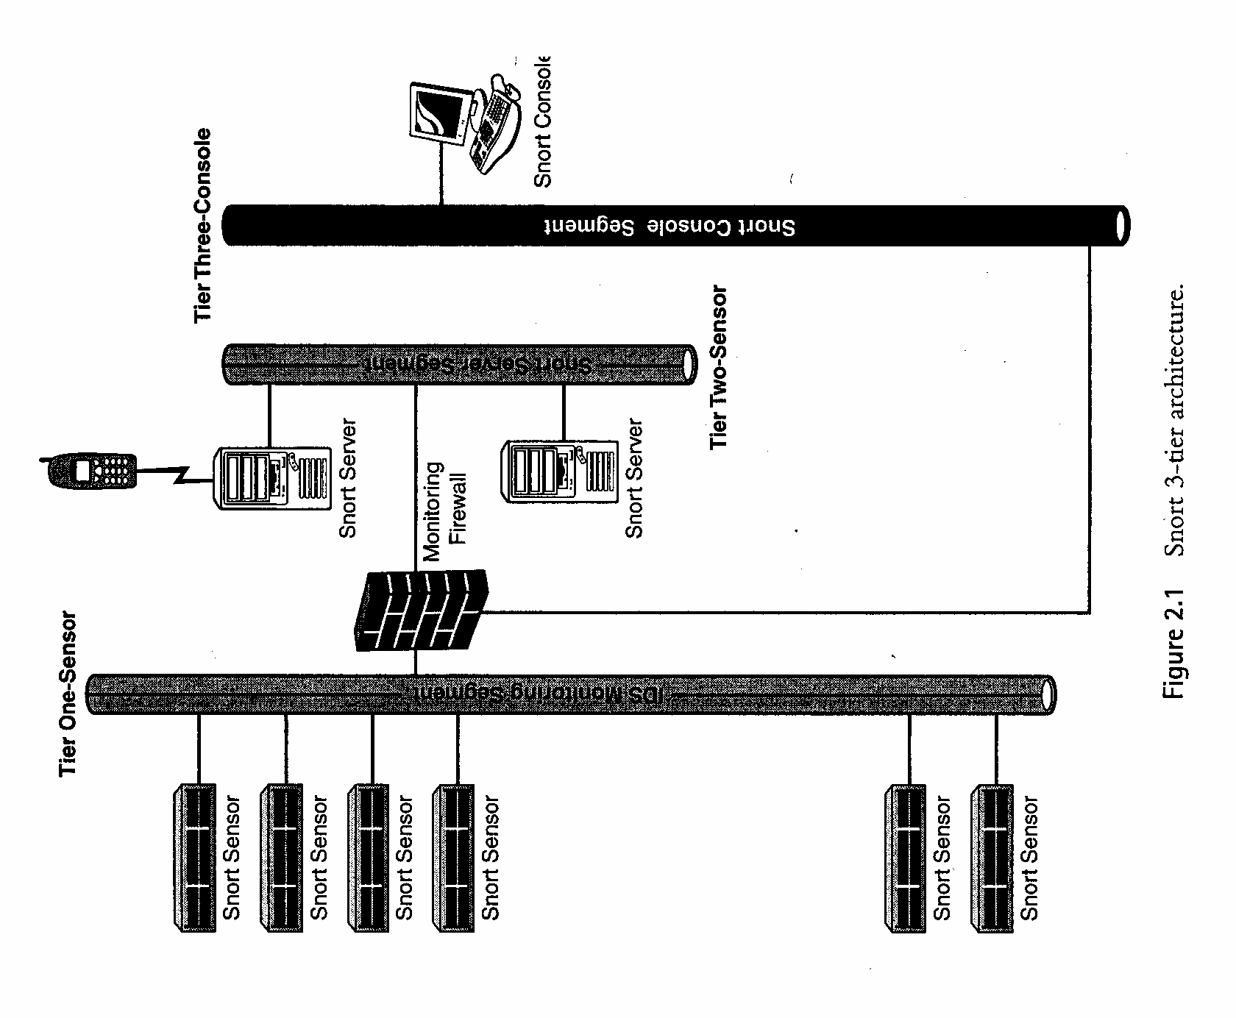

Slide 65
SNORT
Distributed Snort Architecture (cont.)
  First Tier - The Sensor Tier
    The first tier, known as the sensor tier, is where network traffic passes to be monitored for intrusions.
    The sensor acts like a digital vacuum: It collects packets and feeds data up to the second tier.
    The Snort application runs on the sensor; it is responsible for interpreting the nature of collected packets and passing on alerts.

Slide 66
SNORT
Distributed Snort Architecture (cont.)
  First Tier - The Sensor Tier (cont.)
    Sensors have to be placed on the same network segments to be monitored for intrusions, so security is a priority.
    For performance and security reasons, the sensor should have only Snort and its supporting applications running on it and nothing else.
    The sensor has two network cards on it: one for the sniffing interface and one for the management interface.
    The idea is to keep all incoming sniffed packets with one interface, and all outgoing alerts with the other.

Slide 67
SNORT
Distributed Snort Architecture (cont.)
  Second Tier - The Server Tier
    The second tier, or the server tier, gathers alerting data from the sensors and presents the data in a human-readable form.
    The alerting data is fed from Snort into a relational database.
    Snort does not require a relational database; alerts can be logged via other means, such as syslog.
    The most practical way to capture a big amount of alerting data is to organize it in a relational database.

Slide 68
SNORT
Distributed Snort Architecture (cont.)
  Second Tier - The Server Tier (cont.)
    Placing alerts into a database allows performing complex searches to better manage alerting information.
    It also allows other applications to present the data in an easy-to-work-with GUI.
    Snort supports many different databases; supported platforms include Oracle, Postgre SQL, and MySQL.
    Snort is also compatible with any ODBC-compliant database via UnixODBC.

Slide 69
SNORT
Distributed Snort Architecture (cont.)
  Second Tier - The Server Tier (cont.)
    The server tier also supports a GUI that presents data in a human readable form.
    There are several GUIs available for Snort, including demarc, snortsnarf, snortdb, and the ACID.
    The server holds a lot of sensitive and confidential information, and protecting it is a priority.

Slide 70
SNORT
Distributed Snort Architecture (cont.)
  Third Tier - The Analyst's Console
    The third tier, or the analyst's console, is where data are presented.
    The only requirement for the console is a dedicated machine with an SSL-capable web browser installed.

Slide 71
SNORT
Distributed Snort Architecture (cont.)
  Third Tier - The Analyst's Console (cont.)
    ACID works well with Internet Explorer, Mozilla, Netscape, and most other browsers.
    It is a good idea to make the console a dedicated machine, for both physical access control and to keep other applications from interfering with the Intrusion Detection System.

Slide 72
SNORT
Component 6:
Securing SNORT

Slide 73
SNORT
Securing SNORT
  Hardening sensors, servers, and consoles and keeping up to date with patches will keep the intrusion data relatively secure while they rest on the tiers.
  It is equally important to secure the data while it is in transit.

Slide 74
SNORT
Securing SNORT (cont.)
  All the tiers of a Snort IDS utilize encrypted communication and strong authentication to identify a member of one tier to another.
  Stunnel can be used to encrypt alerting communication between the sensor and the server.
  The sensors use digital certificates and strong password authentication to authenticate to the server.

Slide 75
SNORT
Securing SNORT (cont.)
  The server allows only the sensors’ IP addresses to connect to it.
  IP addresses are trivial to spoof, so RFC 1918 IP addresses (for private networks) are used.
  To spoof an IP address, an attacker would have to have access to a host on the IDS segment.

Slide 76
SNORT
Securing SNORT (cont.)
  The browser connects to the ACID Web server via SSL, and the pages are password-protected.
  The server allows only the browser’s IP address to connect to it.

Slide 77
SNORT
Component 7:
SNORT Tuning Performance

Slide 78
SNORT
Fine tuning SNORT after the installation (cont.)
    Some other elements of the SNORT system could also be tuned for a better performance:
      The database (MySQL, etc.)
      ACID
      Updates software/hardware
      Placement
      Etc.

Slide 79
With one firewall and switched network (without IDS)

Slide 80

With one firewall and switched network and IDS connected a spanning port.

Slide 81
Depending upon the type of switches used, you can use Snort on a switch port. Some switches, like Cisco, allow you to replicate all ports traffic on one port where you can attach the Snort machine.
These ports are usually referred to as spanning ports. The best place to install Snort is right behind the firewall or router so that all of the Internet traffic is visible to Snort before it enters any switch or hub.
If the switch you are using has a spanning port, you can connect the IDS machine to the spanning port as shown in figure above. All network traffic, including internal data flowing among company servers and the Internet data, will be visible to the IDS.

Slide 82
With one firewall and connecting an IDS in a switched environment

Slide 83
You can also connect the IDS to a small HUB or a Network TAP right behind the firewall, i.e., between firewall and the switch. In this case all incoming and outgoing traffic is visible to the IDS. The scheme is shown in figure above.
Note that when the IDS is connected as shown in figure above, data flowing among the company servers is not visible to the IDS. The IDS can see only that data which is coming from or going to the Internet. This is useful if you expect attacks from outside and the internal network is a trusted one.

Slide 84
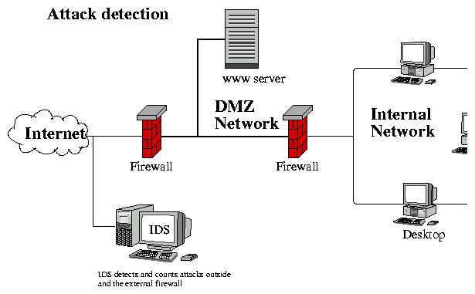
IDS Placement

Slide 85
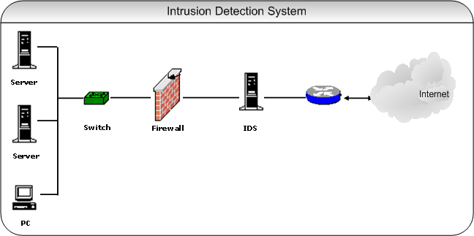
IDS Location (cont.)
Located at choke points in network to be monitored, often in the demilitarized zone (DMZ) or at network borders. The sensor captures all network traffic and analyzes the content of individual packets for malicious traffic.

Slide 86
IDS Placement (cont.)
NIDS is often placed between the edge firewall and back-end firewall that protect internal network from DMZ, or perimeter network or screened subnet.
This will allows it to do job on all traffic that gets through the edge firewall.
Can provides extra layer of protection for the DMZ
Can also be placed behind the back-end firewall to check detect intrusions on the internal LAN.

Slide 87
IDS Placement (cont.)
Refer to extended note in .docx

Slide 88
IDS Working concepts

Slide 89
How its work?
IDS listens to all traffic or packets that crosses in a network segment
IDS then looks at traffic content and analyze it to determine whether it is normal traffic or a possible attack.
If:
  Suspicious: IDS alerts a human who in turn reviews the alert and decides what if any actions should be taken to eliminate the danger posed by the traffic that caused the alert.
  Normal: IDS allows the network traffic or packets

Slide 90
False positive – are problems because they create alert noise that can hide a real attack, and can send you on wild goose chases for attacks that never really happen.
False negative – An IDS might miss an attack because the attack is not one it recognizes, because the IDS is overwhelmed (flooded up), or because the attacker has successfully used a method of evading (avoid) the IDS

Slide 91
SNORT
THE END
Theory Test : Chapter 1 -3
/8/2025: Monday: 2.00 PM- 4 PM
(Objective and Subjective)

